Slide 1

Introduction to Computer Hardware and System Software Concepts

Slide 2
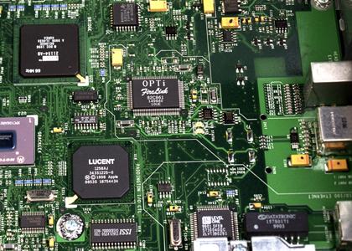
Introduction to Hardware
L1.0

Slide 3
Objectives
To learn and appreciate the following concepts
Block diagram of a computer
Memory system and its types
Input – Output devices

Slide 4
Session outcome
At the end of session the student will be able to understand
Components of the computer system.
Core functionality of the computer system.
How memory systems are utilized.

Slide 5
Introduction to computers
What is a computer?
an electronic device
operates under the control of instructions stored in its own memory unit
accepts data (Input)
manipulates data (Process)
produces information (Output)
Notes:
Additional notes on Introduction to computers
Generally, the term “computer” is used to describe a collection of devices that function together as a system.
Nowadays, computers are an integral part of our lives. They are used for the reservation of tickets for airplanes and railways, payment of telephone and electricity bills, deposit and withdrawal of money from banks, processing of business data, forecasting of weather conditions, diagnosis of diseases, searching for information on the Internet, etc. Computers are also used extensively in schools, universities, organizations, music industry, movie industry, scientific research, law firms, fashion industry, etc.
The term computer is derived from the word compute. The word compute means to calculate. A computer is an electronic machine that accepts data from the user, processes the data by performing calculations and operations on it, and generates the desired output results. Computer performs both simple and complex operations, with speed and accuracy.

Slide 6
Characteristics of a computer
The key characteristics of a computer are
Speed
Accuracy
Diligence – does not get tired
Storage capability
Versatility – doc preparation, play a music at the same time
Notes:
Additional notes on various characteristics of a computer
Speed: The computer can process data very fast, at the rate of millions of instructions per second. Some calculations that would have taken hours and days to complete otherwise, can be completed in a few seconds using the computer. For example, calculation and generation of salary slips of thousands of employees of an organization, weather forecasting that requires analysis of a large amount of data related to temperature, pressure and humidity of various places, etc.
Accuracy: Computer provides a high degree of accuracy. For example, the computer can accurately give the result of division of any two numbers up to 10 decimal places.
Diligence: When used for a longer period of time, the computer does not get tired or fatigued. It can perform long and complex calculations with the same speed and accuracy from the start till the end.
Storage Capability: Large volumes of data and information can be stored in the computer and also retrieved whenever required. A limited amount of data can be stored, temporarily, in the primary memory. Secondary storage devices like floppy disk and compact disk can store a large amount of data permanently.
Versatility: Computer is versatile in nature. It can perform different types of tasks with the same ease. At one moment you can use the computer to prepare a letter document and in the next moment you may play music or print a document.
Computers have several limitations too. Computer can only perform tasks that it has been programmed to do. Computer cannot do any work without instructions from the user. It executes instructions as specified by the user and does not take its own decisions.

Slide 7
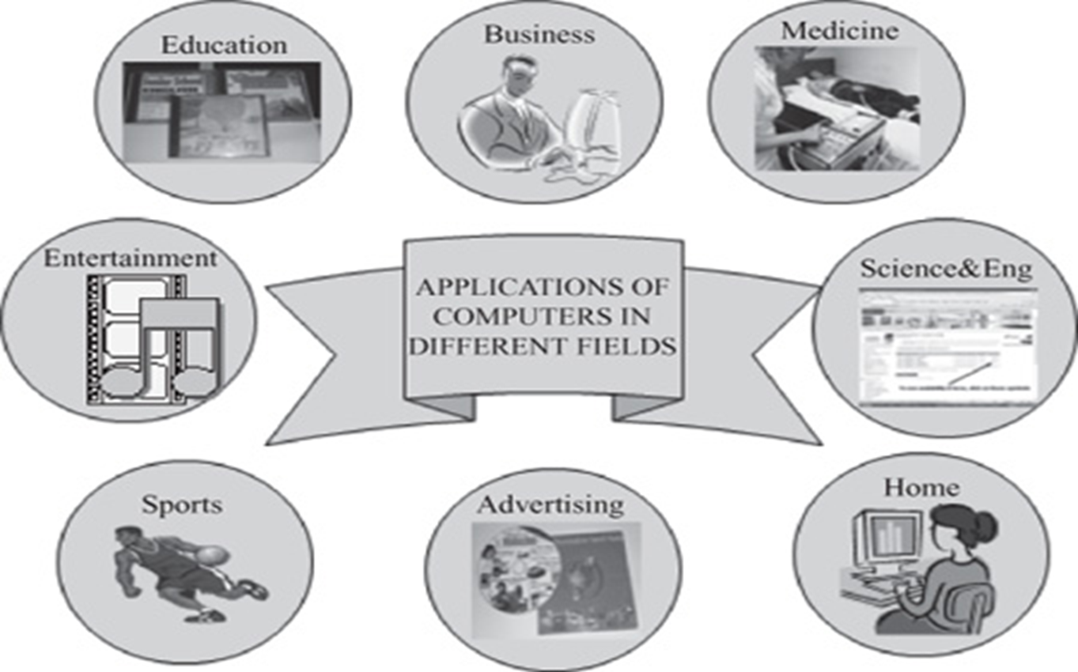
Applications of a Computer
Notes:
Additional notes on various applications of computer
Computers have proliferated into various areas of our lives. For a user, computer is a tool that provides the desired information, whenever needed. You may use computer to get information about the reservation of tickets (railways, airplanes and cinema halls), books in a library, medical history of a person, a place in a map, or the dictionary meaning of a word. The information may be presented to you in the form of text, images, video clips, etc.
Education: Computers are extensively used, as a tool and as an aid, for imparting education. Educators use computers to prepare notes and presentations of their lectures. Computers are used to develop computer-based training packages, to provide distance education using the e-learning software, and to conduct online examinations. Researchers use computers to get easy access to conference and journal details and to get global access to the research material.
Entertainment: Computers have had a major impact on the entertainment industry. The user can download and view movies, play games, chat, book tickets for cinema halls, use multimedia for making movies, incorporate visual and sound effects using computers, etc. The users can also listen to music, download and share music, create music using computers, etc.
Sports: A computer can be used to watch a game, view the scores, improve the game, play games (like chess, etc.) and create games. They are also used for the purposes of training players.
Advertising: Computer is a powerful advertising media. Advertisement can be displayed on different websites, electronic-mails can be sent and reviews of a product by different customers can be posted. Computers are also used to create an advertisement using the visual and the sound effects. For the advertisers, computer is a medium via which the advertisements can be viewed globally. Web advertising has become a significant factor in the marketing plans of almost all companies. In fact, the business model of Google is mainly dependent on web advertising for generating revenues.
Medicine: Medical researchers and practitioners use computers to access information about the advances in medical research or to take opinion of doctors globally. The medical history of patients is stored in the computers. Computers are also an integral part of various kinds of sophisticated medical equipments like ultrasound machine, CAT scan machine, MRI scan machine, etc. Computers also provide assistance to the medical surgeons during critical surgery operations like laparoscopic operations, etc.
Science and Engineering: Scientists and engineers use computers for performing complex scientific calculations, for designing and making drawings (CAD/CAM applications) and also for simulating and testing the designs. Computers are used for storing the complex data, performing complex calculations and for visualizing 3-dimensional objects. Complex scientific applications like the launch of the rockets, space exploration, etc., are not possible without the computers.
Government: The government uses computers to manage its own operations and also for e-governance. The websites of the different government departments provide information to the users. Computers are used for the filing of income tax return, paying taxes, online submission of water and electricity bills, for the access of land record details, etc. The police department uses computers to search for criminals using fingerprint matching, etc.
Home Computers have now become an integral part of home equipment. At home, people use computers to play games, to maintain the home accounts, for communicating with friends and relatives via Internet, for paying bills, for education and learning, etc. Microprocessors are embedded in house hold utilities like, washing machines, TVs, food processors, home theatres, security devices, etc.
The list of applications of computers is so long that it is not possible to discuss all of them here. In addition to the applications of the computers discussed above, computers have also proliferated into areas like banks, investments, stock trading, accounting, ticket reservation, military operations, meteorological predictions, social networking, business organizations, police department, video conferencing, tale presence, book publishing, web newspapers, and information sharing.

Slide 8
Various Computing devices
Notes:
Additional notes on various computing devices
If you use a desktop computer, you might already know that there isn't any single part called the "computer." A computer is really a system of many parts working together. The physical parts, which you can see and touch, are collectively called hardware. (Software, on the other hand, refers to the instructions, or programs, that tell the hardware what to do.)
The system unit
The system unit is the core of a computer system. Usually it's a rectangular box placed on or underneath your desk. Inside this box are many electronic components that process information. The most important of these components is the central processing unit (CPU), or microprocessor, which acts as the "brain" of your computer. Another component is random access memory (RAM), which temporarily stores information that the CPU uses while the computer is on. The information stored in RAM is erased when the computer is turned off.
Almost every other part of your computer connects to the system unit using cables. The cables plug into specific ports (openings), typically on the back of the system unit. Hardware that is not part of the system unit is sometimes called a peripheral device or device.
Storage
Your computer has one or more disk drives—devices that store information on a metal or plastic disk. The disk preserves the information even when your computer is turned off.
Hard disk drive
Your computer's hard disk drive stores information on a hard disk, a rigid platter or stack of platters with a magnetic surface. Because hard disks can hold massive amounts of information, they usually serve as your computer's primary means of storage, holding almost all of your programs and files. The hard disk drive is normally located inside the system unit.
CD and DVD drives
Nearly all computers today come equipped with a CD or DVD drive, usually located on the front of the system unit. CD drives use lasers to read (retrieve) data from a CD, and many CD drives can also write (record) data onto CDs. If you have a recordable disk drive, you can store copies of your files on blank CDs. You can also use a CD drive to play music CDs on your computer.
Floppy disk drive
Floppy disk drives store information on floppy disks, also called floppies or diskettes. Compared to CDs and DVDs, floppy disks can store only a small amount of data. They also retrieve information more slowly and are more prone to damage. For these reasons, floppy disk drives are less popular than they used to be, although some computers still include them.
Mouse
A mouse is a small device used to point to and select items on your computer screen. Although mice come in many shapes, the typical mouse does look a bit like an actual mouse. It's small, oblong, and connected to the system unit by a long wire that resembles a tail. Some newer mice are wireless.
Keyboard
A keyboard is used mainly for typing text into your computer. Like the keyboard on a typewriter, it has keys for letters and numbers, but it also has special keys:
The function keys, found on the top row, perform different functions depending on where they are used.
The numeric keypad, located on the right side of most keyboards, allows you to enter numbers quickly.
The navigation keys, such as the arrow keys, allow you to move your position within a document or webpage.
Monitor
A monitor displays information in visual form, using text and graphics. The portion of the monitor that displays the information is called the screen. Like a television screen, a computer screen can show still or moving pictures.
There are two basic types of monitors: CRT (cathode ray tube) monitors and LCD (liquid crystal display) monitors. Both types produce sharp images, but LCD monitors have the advantage of being much thinner and lighter. CRT monitors, however, are generally more affordable.
Printer
A printer transfers data from a computer onto paper. You don't need a printer to use your computer, but having one allows you to print e‑mail, cards, invitations, announcements, and other materials. Many people also like being able to print their own photos at home.
The two main types of printers are inkjet printers and laser printers. Inkjet printers are the most popular printers for the home. They can print in black and white or in full color and can produce high-quality photographs when used with special paper. Laser printers are faster and generally better able to handle heavy use.
Speakers
Speakers are used to play sound. They may be built into the system unit or connected with cables. Speakers allow you to listen to music and hear sound effects from your computer.
Modem
To connect your computer to the Internet, you need a modem. A modem is a device that sends and receives computer information over a telephone line or high-speed cable. Modems are sometimes built into the system unit, but higher-speed modems are usually separate components.

Slide 9
What Does A Computer Do?
Computers can perform four general operations, which comprise the information processing cycle.
Input
Process/Computation
Storage
Output
Notes:
Additional notes - what does a computer do?
A computer is a basic technology that is a better resource to other than books, radio, and etc...It also is more accurate on all topics and many different features.

Slide 10
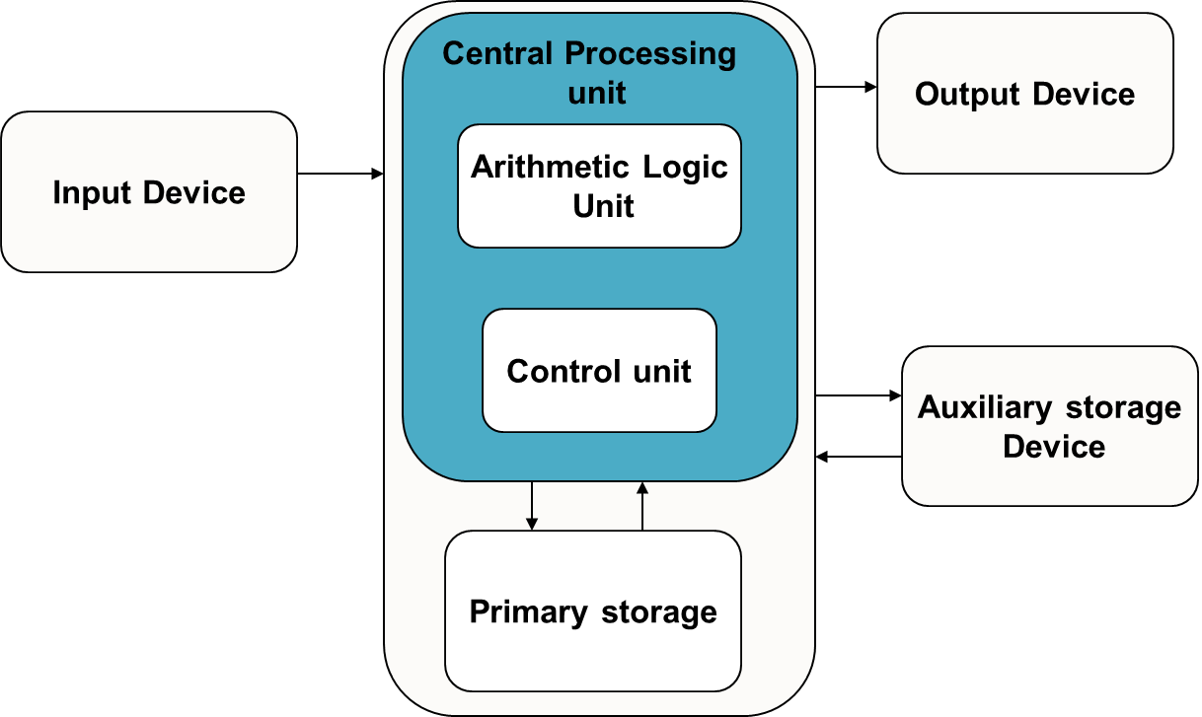
Block Diagram of a Computer
Notes:
Additional notes on computing process information
A computer can process data, pictures, sound and graphics. They can solve highly complicated problems quickly and accurately. There are basically five major computer operations or functions irrespective of their size and make. They are
1) It accepts data or instructions by way of input,
2) It stores data,
3) It can process data as required by the user,
4) It gives results in the form of output, and
5) It controls all operations inside a computer.
Computer operations
1. Input: This is the process of entering data and programs in to the computer system. You should know that computer is an electronic machine like any other machine which takes as inputs raw data and performs some processing giving out processed data. Therefore, the input unit takes data from us to the computer in an organized manner for processing.
2. Storage: The process of saving data and instructions permanently is known as storage. Data has to be fed into the system before the actual processing starts. It is because the processing speed of Central Processing Unit (CPU) is so fast that the data has to be provided to CPU with the same speed. Therefore the data is first stored in the storage unit for faster access and processing. This storage unit or the primary storage of the computer system is designed to do the above functionality. It provides space for storing data and instructions.
The storage unit performs the following major functions:
• All data and instructions are stored here before and after processing.
• Intermediate results of processing are also stored here.
3. Processing: The task of performing operations like arithmetic and logical operations is called processing. The Central Processing Unit (CPU) takes data and instructions from the storage unit and makes all sorts of calculations based on the instructions given and the type of data provided. It is then sent back to the storage unit.
4. Output: This is the process of producing results from the data for getting useful information. Similarly the output produced by the computer after processing must also be kept somewhere inside the computer before being given to you in human readable form. Again the output is also stored inside the computer for further processing.
5. Control: The manner how instructions are executed and the above operations are performed. Controlling of all operations like input, processing and output are performed by control unit. It takes care of step by step processing of all operations inside the computer.

Slide 11
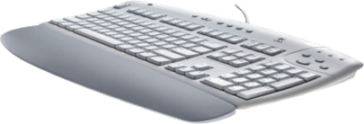
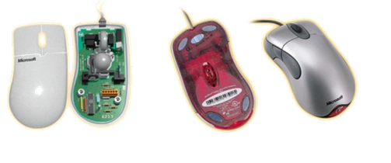
Input devices
An external device connected to the CPU
To feed data and instructions for solving the problem
Keyboard
Mouse
Joystick
Light pen
Trackball
Optical Scanner
Voice input
Notes:
Notes on Input devices
Input devices allow users and other applications to input data into the computer, for processing. The data input to a computer can be in the form of text, audio, video, etc.

Slide 12
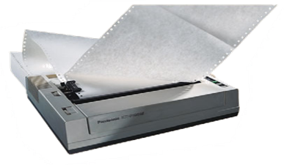
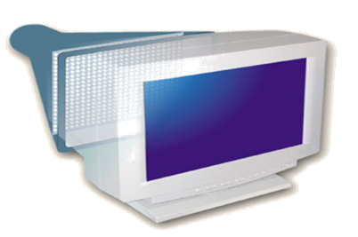
Output devices
To display the results
printer
plotter
plasma display panels
LCD displays
voice output
Notes:
Notes on Output devices
Output devices provide output to the user, which is generated after processing the input data. The processed data, presented to the user via the output devices could be text, graphics, audio or video. The output could be on a paper or on a film in a tangible form, or, in an intangible form as audio, video and electronic form.

Slide 13
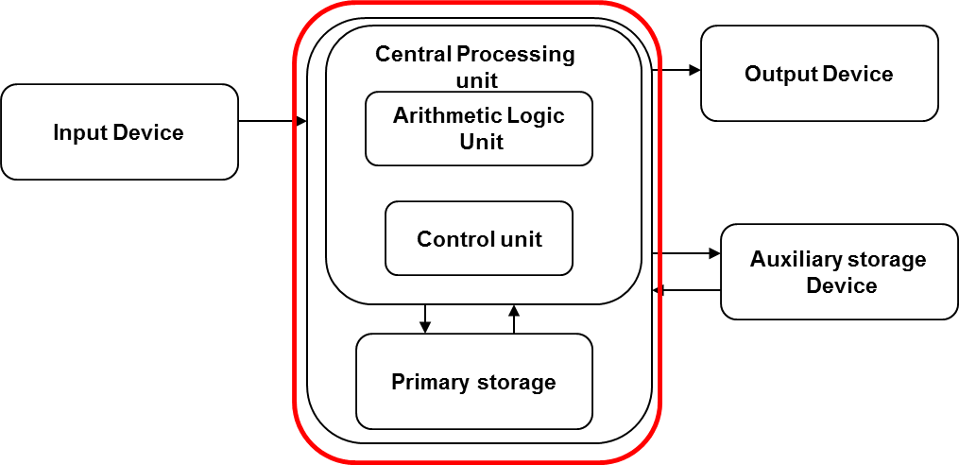
System unit
The Central Processing Unit + Memory Unit
Data and instructions received from the input device are stored and processed in this unit
Notes:
Notes on functional units of a computer
In order to carry out the operations mentioned in the previous section the computer allocates the task between its various functional units. The computer system is divided into three separate units for its operation. They are
1) arithmetic logical unit
2) control unit.
3) central processing unit.

Slide 14
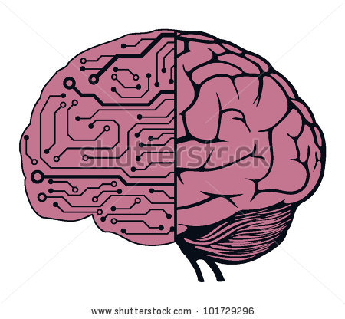
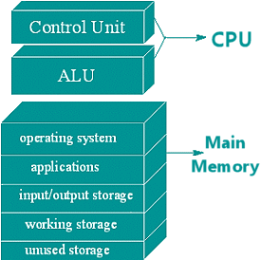
Central Processing Unit
Data and instructions are processed in CPU
Consists of two functional units
Control Unit (CU)
Arithmetic and Logic Unit (ALU)
Notes:
Additional notes on CPU
Central Processing Unit (CPU) or the processor is also often called the brain of computer. In addition, CPU also has a set of registers which are temporary storage areas for holding data, and instructions. ALU performs the arithmetic and logic operations on the data that is made available to it. CU is responsible for organizing the processing of data and instructions. CU controls and coordinates the activity of the other units of computer. CPU uses the registers to store the data, instructions during processing.

Slide 15
Arithmetic and Logical unit
Performs arithmetic and logical operations:
Example:
arithmetic(+,-,*,/ etc..) and
logical (AND, OR, NOT, <,= etc..) operations
Notes:
Additional notes on ALU
An eight bit instruction informs the ALU which operation it is to carry out. One number to be manipulated comes from the accumulator, the other from memory or another register. The result is stored in the accumulator. Flags in the status register are set to indicate the result, such as negative etc.

Slide 16
Control unit
Controls the order in which your program instructions are executed.
Functions of CU:
Fetches data and instructions to main memory
Interprets these instructions
Controls the transfer of data and instructions to and from main memory
Controls input and output devices.
Overall supervision of computer system
Notes:
Additional notes on CU
A control unit is circuitry that directs operations within the computer's processor by directing the input and output of a computer system. The processor then controls how the rest of the computer operates (giving directions to the other parts and systems). A control unit works by gathering input through a series of commands it receives from instructions in a running programs and then outputs those commands into control signals that the computer and other hardware attached to the computer carry out.
The control unit is basically circuitry inside the CPU, controlling the operations inside the CPU and "directing traffic" in a sense. The functions a control unit performs can depend on the type of CPU, since the varying degrees of architecture between all the different CPUs will determine the functions of the control unit.

Slide 17
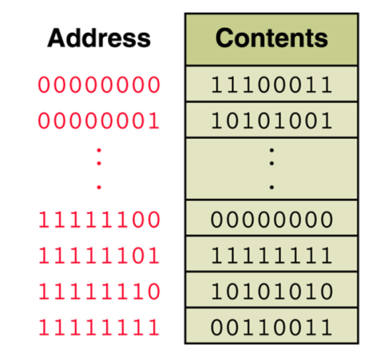
Memory unit
Storage device where the data and instructions fed by the user are stored
An ordered sequence of storage cells, each capable of holding a piece of information
Each cell has its own unique address
The information held can be input data, computed values, or your program instructions.
Notes:
Additional notes on memory
The computer starts using the memory from the moment the computer is switched on, till the time it is switched off. The list of steps that the computer performs from the time it is switched on are—
1. Turn the computer on.
2. The computer loads data from ROM. It makes sure that all the major components of the computer are functioning properly.
The computer loads the BIOS from ROM. The BIOS provides the most basic information about storage devices, boot sequence, security, plug and play capability and other items.
3. The computer loads the OS from the hard drive into the system’s RAM. CPU has immediate access to the OS as the critical parts of the OS are maintained in RAM as long as the computer is on. This enhances the performance and functionality of the overall system.
4. Now the system is ready for use.
5. When you load or open an application it is loaded in the RAM. Since the CPU looks for information in the RAM, any data and instructions that are required for processing (read, write or update) is brought into RAM. To conserve RAM usage, many applications load only the essential parts of the program initially and then load other pieces as needed. Any files that are opened for use in that application are also loaded into RAM.
6. The CPU requests the data it needs from RAM, processes it and writes new data back to RAM in a continuous cycle. The shuffling of data between the CPU and RAM happens millions of times every second.
7. When you save a file and close the application, the file is written to the secondary memory as specified by you. The application and any accompanying files usually get deleted from RAM to make space for new data.
8. If the files are not saved to a storage device before being closed, they are lost.
The memory unit is the part of the computer that holds data and instructions for processing. Although it is closely associated with the CPU, in actual fact it is separate from it. Memory associated with the CPU is also called primary storage, primary memory, main storage, internal storage and main memory. When we load software from a floppy disk, hard disk or CD-ROM, it is stored in the memory unit.

Slide 18
Memory unit
The computer memory is measured in terms of bits, bytes and words.
A bit is a binary digit either 0 or 1.
A byte is unit of memory and is defined as sequence of 8 bits.
The word can be defined as a sequence of 16/32/64 bits or 2/4/8 bytes respectively depending on the machine architecture.
Notes:
Additional notes on memory units
The computer’s memory stores data, instructions required during the processing of data, and output results. Storage may be required for a limited period of time, instantly, or, for an extended period of time. Different types of memories, each having its own unique features, are available for use in a computer. The cache memory, registers, and RAM are fast memories and store the data and instructions temporarily during the processing of data and instructions. The secondary memories like magnetic disks and optical disks have large storage capacities and store the data and instructions permanently, but are slow memory devices. The memories are organized in the computer in a manner to achieve high levels of performance at the minimum cost.

Slide 19
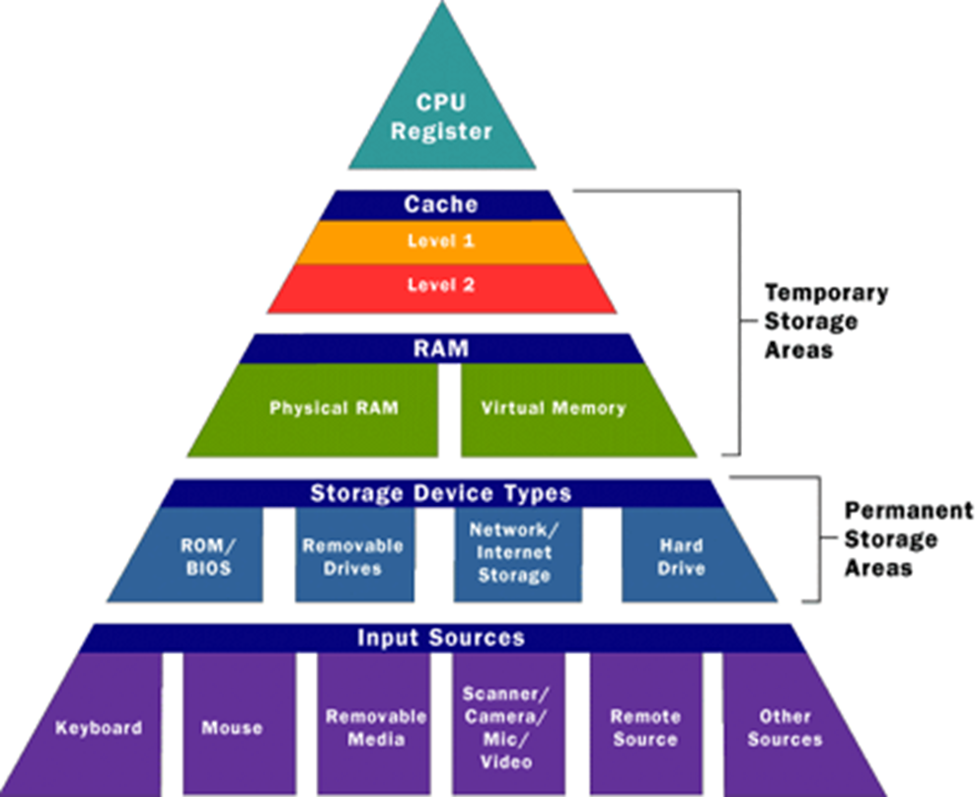
Memory hierarchy
Notes:
Additional notes on memory hierarchy
The memory is characterized on the basis of two key factors—capacity and access time. Capacity is the amount of information (in bits) that a memory can store. Access time is the time interval between the read/write request and the availability of data. The lesser the access time, the faster is the speed of memory. Ideally, we want the memory with fastest speed and largest capacity. However, the cost of fast memory is very high. The computer uses a hierarchy of memory that is organized in a manner to enable the fastest speed and largest capacity of memory.

Slide 20
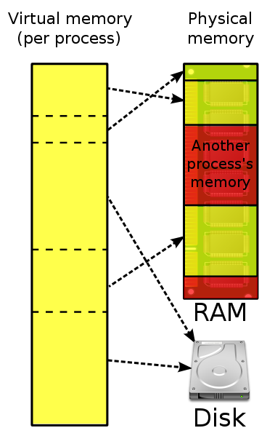
Virtual Memory
Notes:
Virtual memory combines active RAM and inactive memory on DASD (direct access storage device) to form a large range of contiguous addresses.

Slide 21
Main – Primary memory
Memory where the data and instructions, currently being executed are stored
Located outside CPU
High speed
Data and instructions stored get erased when the power goes off
Also referred as primary / temporary memory
Semiconductor memory
Measured in terms of megabytes and gigabytes
Notes:
Additional notes associated with main memory
Primary memory is the main memory of computer.
It is a chip mounted on the motherboard of computer.
Primary memory is categorized into two main types- Random Access Memory (RAM), and Read Only Memory (ROM).

Slide 22
Secondary storage devices
Main memory is volatile and limited
Hence it is essential for other types of storage devices where programs and data can be stored when they are no longer being processed
Installed within the computer box at the factory or added later as needed
Notes:
Additional notes on secondary storage devices
Secondary memory on a computer is storage for data and programs not in use at the moment. In addition to punched cards and paper tape, early computers also used magnetic tape for secondary storage. Tape is cheap, either on large reels or in small cassettes, but has the disadvantage that it must be read or written sequentially from one end to the other.

Slide 23
Secondary Storage Devices
Non-volatile memory
Made up of magnetic material
Stores large amount of information for long time
Low speed
Holds programs not currently being executed
Notes:
Input, output, and auxiliary/secondary storage devices attached to a computer are called peripherals. E.g. Magnetic tapes, magnetic disks, compact disks etc.

Slide 24
Computer memory classifications
Main memory-Primary storage
Secondary memory-Auxiliary storage
Cache Memory

Slide 25
Primary storage: RAM & ROM
RAM stands for Random Access Memory
Read and write memory
Information typed by the user are stored in this
memory
Any memory location can be accessed directly without scanning it sequentially (random access memory)
During power failure the information stored in it will be erased → volatile memory
ROM stands for Read Only Memory
Permanent memory and non volatile
Contents in locations in ROM can not be changed
Stores mainly stored program and basic input output system programs
Syntax
Additional Information
Do’s
Don’ts
Video clip
Case studies
Do it yourself

Slide 26
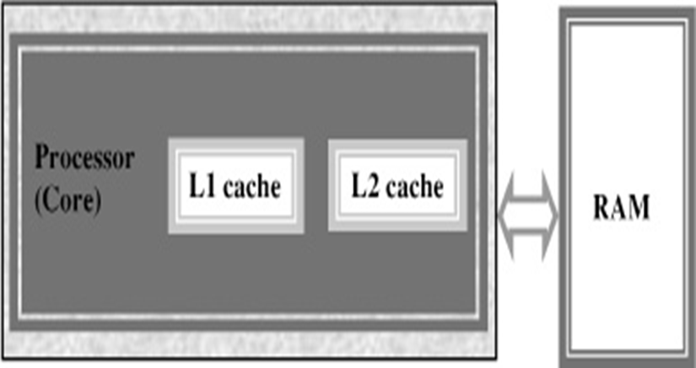
Cache memory
High speed memory placed between CPU and main memory
Stores data and instructions currently to be executed
More costlier but less capacity than main memory
Users can not access this memory
Notes:
Additional notes on cache memory
The data and instructions that are required during the processing of data are brought from the secondary storage devices and stored in the RAM. For processing, it is required that the data and instructions are accessed from the RAM and stored in the registers. The time taken to move the data between RAM and CPU registers is large. This affects the speed of processing of computer, and results in decreasing the performance of CPU.
Cache memory is a very high speed memory placed in between RAM and CPU. Cache memory increases the speed of processing.
Cache memory is a storage buffer that stores the data that is used more often, temporarily, and makes them available to CPU at a fast rate. During processing, CPU first checks cache for the required data. If data is not found in cache, then it looks in the RAM for data.
To access the cache memory, CPU does not have to use the motherboard’s system bus for data transfer. (The data transfer speed slows to the motherboard’s capability, when data is passed through system bus. CPU can process data at a much faster rate by avoiding the system bus.)
Cache memory is built into the processor, and may also be located next to it on a separate chip between the CPU and RAM. Cache built into the CPU is faster than separate cache, running at the speed of the microprocessor itself. However, separate cache is roughly twice as fast as RAM.
The CPU has a built-in Level 1 (L1) cache and Level 2 (L2) cache. In addition to the built-in L1 and L2 cache, some CPUs have a separate cache chip on the motherboard. This cache on the motherboard is called Level 3 (L3) cache. Nowadays, high-end processor comes with built-in L3 cache, like in Intel core i7. The L1, L2 and L3 cache store the most recently run instructions, the next ones and the possible ones, respectively. Typically, CPUs have cache size varying from 256KB (L1), 6 MB (L2), to 12MB (L3) cache.

Slide 27
Summary
Computer is an electronic device which accepts data as input, performs processing on the data, and gives the desired output.
Speed, accuracy, diligence, storage capability and versatility are the main characteristics of computer.
Input/output Unit, CPU and Memory unit are the three main components of computer.
CPU consists of ALU, CU and Registers. The memory unit stores programs, data and output, temporarily, during the processing. Additionally, storage unit or secondary memory is used for the storing of programs, data and output permanently.
Syntax
Additional Information
Do’s
Don’ts
Video clip
Case studies
Do it yourself

